Slide 1
MINI PROJECT REVIEW I
Venkatraman S (123012046)
Ambhareesh M D (123012008
Sethunarayanan S (123012057)
Guide:
Prof. Dr.Harikrishnan R

Slide 2
Table of Contents
Problem Statement
Literature Survey
Work plan
Work carried out

Slide 3
PROBLEM STATEMENT
Develop a simulation model of a complete locomotion system specifically designed to traverse to a railway platform, board it and traverse to the designated seat and enable self-transfer.

Slide 4
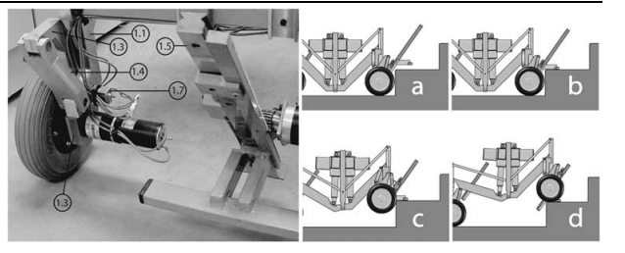
LITERATURE SURVEY
Morales, R., Gonzalez, A., Feliu, V. et al. Environment adaptation of a new staircase-climbing wheelchair. Auton Robot 23, 275–292 (2007). https://doi.org/10.1007/s10514-007-9047-6

Slide 5
This Paper presents a complete model of Step climbing Robot.
Here the model uses 2 decoupled mechanisms:
1. Stair climbing wheel chair mechanism with high single step capability
2. Passenger positioning mechanism.
Working:
A rack is actuated to lift the front wheel, until it reaches the step height. Then wheels are deployed back and weight is transferred at once to the front wheels and then back wheels climb the stair.
A parallel mechanism, with the mobile platform is connected to the base using 2 serial kinematic chain maintains vertical stability

Slide 6
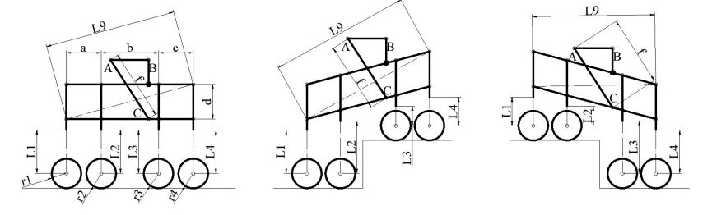
REFERENCE 2
D. Delgado-Mena, E. Pereira, C. Alén-Cordero, S. Maldonado-Bascón and P. Gil-Jiménez, "Control architecture for a novel Leg-Based Stair-Climbing Wheelchair," 2021 European Conference on Mobile Robots (ECMR), 2021, pp. 1-6, doi: 10.1109/ECMR50962.2021.9568794.
https://ieeexplore.ieee.org/stamp/stamp.jsp?tp=&arnumber=9568794&isnumber=9568783

Slide 7
This Paper presents the design of a 3 level Kinematic Control architecture of a step climbing wheelchair model using 17 actuators.
Level 1: Each wheel is controlled individually (Traction control)
Level 2: A pair is controlled along with control of vertical actuation of wheels. (Step climbing)
Level 3: Co-ordination of Horizontal and vertical movement of
wheels to stabilize the passenger through inputs from a gyroscope sensor. (Vertical stabilization of Passenger while climbing)

Slide 8
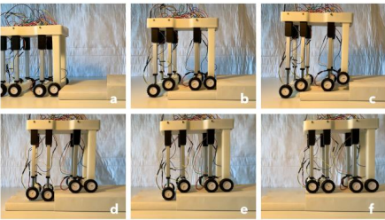
REFERENCE 3
Y. Ma and F. Lyu, "Design of A Wheel-Legged Stair Climbing Robot," 2021 7th International Conference on Control, Automation and Robotics (ICCAR), 2021, pp. 146-150, doi: 10.1109/ICCAR52225.2021.9463485.
https://ieeexplore.ieee.org/stamp/stamp.jsp?tp=&arnumber=9463485&isnumber=9463319

Slide 9
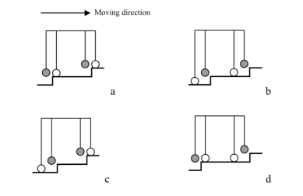
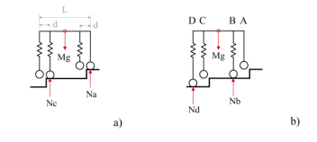
This paper presents a wheel-legged robot capable of overcoming steps and climbing stairs with 6 linear actuators as legs.
It has 4 wheel motors with 6 active linkages/legs.
Only 2 pairs of the legs share the load during climbing and the third is directly in contact with the ground and the other leg acts as auxiliary , no critical function.

Slide 10
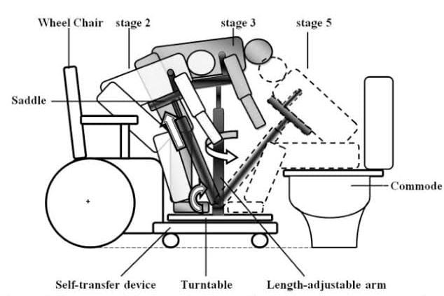
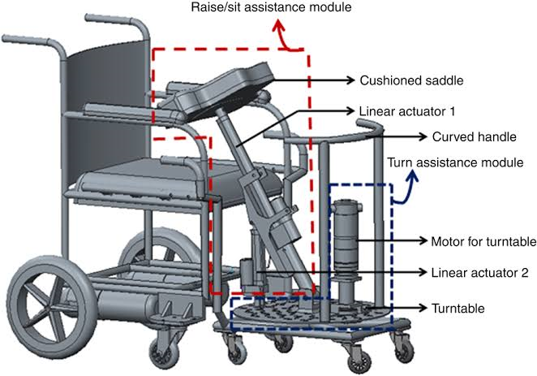
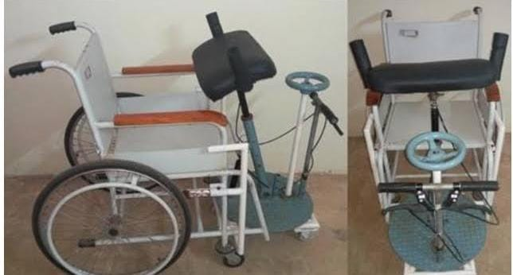
REFERENCE 4
N. Shashank Shivakumar, V. Shreyaas Viishvak, R. B. K. Ashok and R. Hari Krishnan, "Development of a Mechanism to Dock a Robotic Self-Transfer Device to a Wheelchair," 2019 IEEE International Conference on System, Computation, Automation and Networking (ICSCAN), 2019, pp. 1-5, doi: 10.1109/ICSCAN.2019.8878755.

Slide 11
This Paper presents a novel mechanical self transfer model that employs Lockable gas springs for raising, while a turntable with epicyclic gear train facilitates rotary transfer.
https://doi.org/10.1115/1.4032867

Slide 12
WORK PLAN
We plan to use CoppeliaSim Software to develop a Wheelchair model with autonomous stair climbing ability and motion using IR, Proximity sensor and a vision sensor for path planning and obstacle avoidance.
Then, we plan to integrate the model with Self transferring feature.
The control system of the proposed device will be developed using MATLAB software and will be integrated with the developed model using the simulation framework CoppeliaSim.

Slide 13
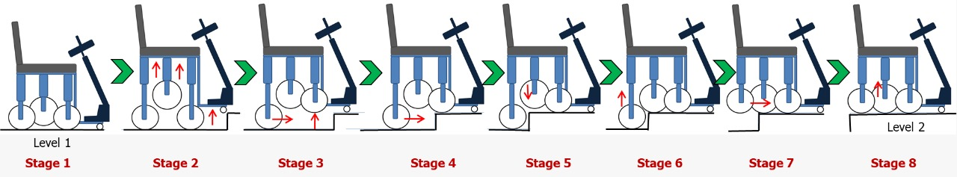
Step climbing sequence:
Initially wheel chair is moving in the flat terrain (platform) with the centre of gravity at the central wheel.
The front wheel touches the step.
The central wheel goes up and followed by front wheel. Then with the help of rear wheel it go front.
Now the rear motor acts so that the front wheel follows the terrain profile and reaches the horizontal part of the step.
Now the central wheel comes down and rear wheel goes up.
Then the front motor acts until the rear wheel comes to horizontal part of the step. Atlast central wheel goes up when both front and rear wheel climbed the step.
The climbing sequence is over.

Slide 14
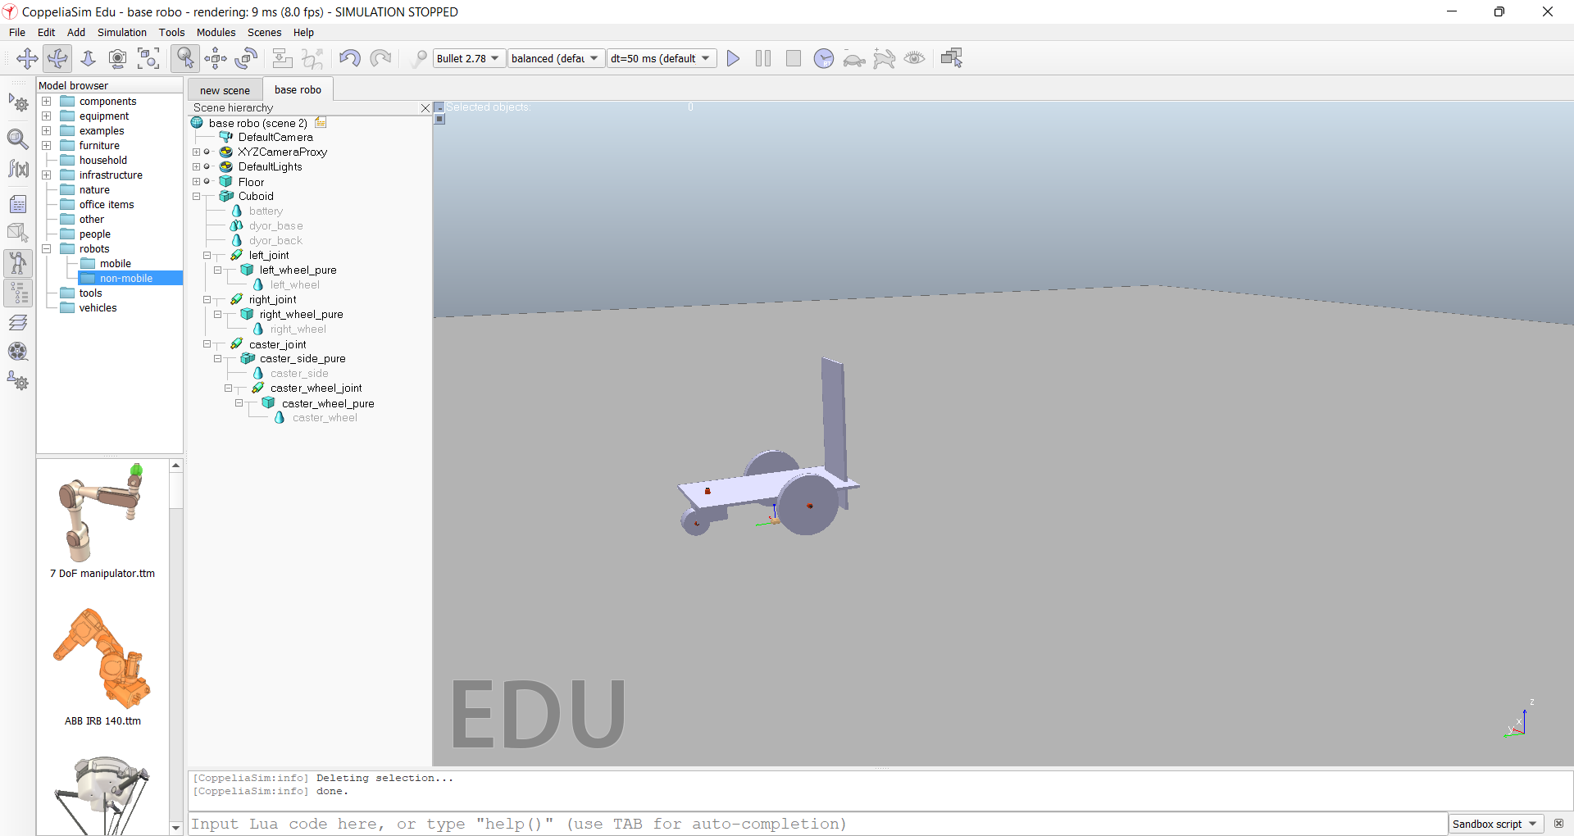
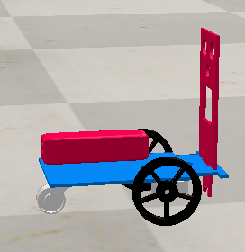
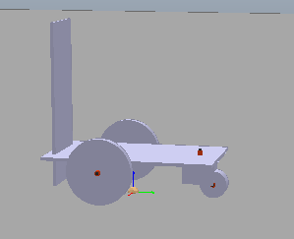
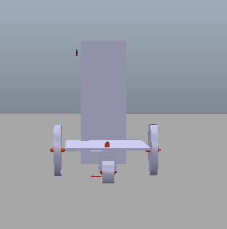
WORK CARRIED OUT
We created a simple DYOR base mobile vehicle in CoppeliaSim using pure objects and we studied their object properties such as translation, rotation and we configured the revolute joints for the wheels.

Slide 15
We configured the joints to be velocity controlled (for now) and connected the servo motors.
What are we working currently on?
We are currently working on balancing the masses of the pure objects
so that the vehicle does not misbehave during motion.
We further will add prismatic joints to the intersection of base link and wheel support for all 3 wheels.
Additionally, we will add an Omni wheel in the center of the base with an actuator via prismatic joint and share the whole load equally in the front too along with prismatic joint and actuators.

Slide 16
THANK YOU

